Slide 1
Database Management Systems
Dr. Sadhana Jha
Computer Science and Information Systems Department
BITS, Pilani

Slide 2
Operations on Relations:
Relational Algebra

Slide 3
Query Language
Language in which the user requests information from the database.
Procedural or non-procedural
Instructs the system to perform a sequence of operations on database to compute desired result. E.g. Relational algebra
User describes the desired information without giving specific procedure for obtaining the information. E.g. tuple relational calculus and domain relational calculus.

Slide 4
Relational Query Languages
Procedural languages:
Relational algebra (RA)
Tuple relational calculus (TRC)
Domain relational calculus (DRC)
The above 3 languages are equivalent in computing power
Procedural relational query language defines a set of operations that operate on tables and outputs table
Provides a set of operations that take one or more relations as input and return a relation as output.
SQL is based on relational algebra. Adds more to it.
consists of 6 basic operations

Slide 5
Basic Operations in Relational Algebra
select
project
set-union
set-difference
cartesian product
rename

Slide 6
Select Operation
Notation: σ_{p}(r), where p is called the selection predicate and r is the relation name
Defined as:
σ_{p}(r) = {t | t ∈ r and p(t)}
where p is a formula in propositional calculus consisting of terms connected by : ∧ (and), ∨ (or), ¬ (not)
Each term is one of: <attribute_name> op <attribute_value>/<attribute_name>/constant, where op is one of: =, ≠, >, ≥, <, ≤

Slide 7
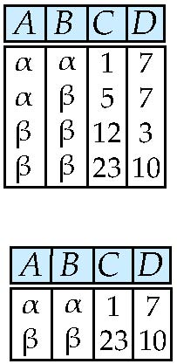
Example of Select Operation
Relation r
σ_{A=B ^ D > 5} (r)

Slide 8
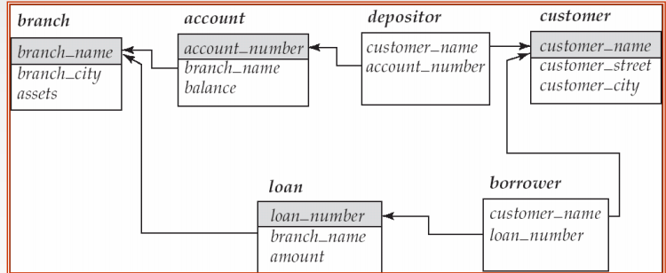
Q: Select the details of all the accounts opened in “Pilani” branch of bank B.
σ_{branch_name = “Pilani”} (account)
Q: Select the details of all the loans approved in “Pilani” branch and the amount is greater then 50lacs.
σbranch_name = “Pilani” ∧ amount > 5000000(account)

Slide 9
Project Operation
Notation: ∏ _{A1, A2,…., An} (r), where _{A1, A2,…., An} are attribute names and r is a relation name
Duplicate rows removed from result, since relations are sets
Used for eliminating extra information

Slide 10
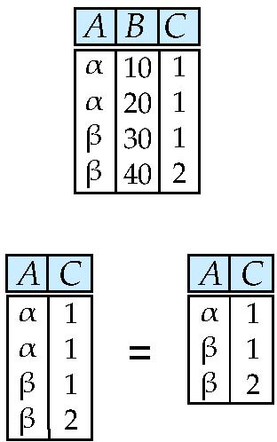
Example of Projection Operation
Relation r:
∏_{A,C} (r)

Slide 11
Q: View account_number and balance of all the customers of the bank.
∏_{account_number, balance} (account)

Slide 12
Union Operation
Notation: r ∪ s
Defined as: r ∪ s = {t | t ∈ r or t ∈ s}
For r ∪ s to be valid, r and s needs to be union compatible, i.e.:
r, s must have the same arity (same number of attributes)
The attribute domains must be compatible (example: 2nd column of r deals with the same type of values as does the 2nd column of s)

Slide 13
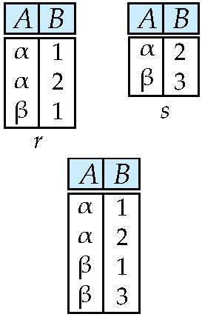
Example of Union Operation
Relations r, s:
r ∪ s:

Slide 14
Q: Find all customers with either an account or a loan
A: ∏_{customer_name} (depositor) ∪ ∏_{customer_name} (borrower)

Slide 15
Set Difference Operation
Notation: r – s
Defined as: r – s = {t | t ∈ r and t ∉ s}
For r – s to be valid, r and s needs to be union compatible.
A | B
α | 1
α | 2
β | 1
A | B
α | 2
β | 3
A | B
α | 1
β | 1
s
r-s
r

Slide 16
Q: Find the branches of the bank B which have not sanctioned any loan yet
∏_{branch_name} (branch) - ∏_{branch_name} (loan)

Slide 17
Cartesian-product
Notation: r x s
Defined as: r x s = {t q | t ∈ r and q ∈ s}
Assumes that attributes of r(R) and s(S) are disjoint. (That is, R ∩ S = ∅)
If attributes of r(R) and s(S) are not disjoint, then renaming is done

Slide 18
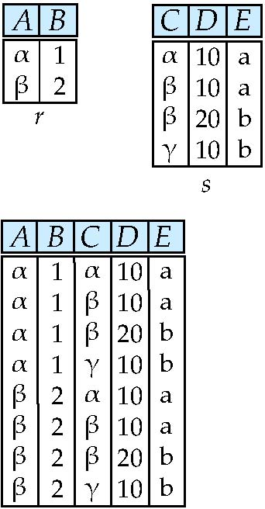
Cartesian-product
Relations r, s:
r x s:

Slide 19
Cartesian-product – naming issue
B
Relations r, s:
r.B
s.B
r x s:

Slide 20
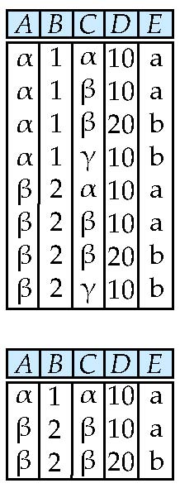
Composition of Operations
Building expressions using multiple operations
Example: σ_{A=C} (r x s)
σ_{A=C} (r x s)
σ_{A=C} (r x s)
r X s

Slide 21
Q: Find all the account number associated with the branch “Pilani” of bank B
∏_{account_number}(σ_{branch_name = “Pilani”} (account))

Slide 22
Rename Operation
Allows to name, and therefore to refer to, the results of relational algebra expressions
Allows to refer to a relation by more than one name
Example: ρ_{x}(E) returns the expression E under the name X
If a relational-algebra expression E has arity n, then
ρ_{x(A1 , A2 , …., An)}(E)
returns the result of expression E under the name X, and with the attributes renamed to A₁ , A₂ , …., A_{n} .

Slide 23
Q: Find all the account number associated with the branch “Pilani” of bank B. Rename the account_number column of the result to AN.
ρ_{x(AN)}(∏_{account_number}(σ_{branch_name = “Pilani”} (account))

Slide 24
Formal Definition
A basic expression in RA consists of either one of the following:
A relation in the database
A constant relation
If E1 and E2 are two RA expressions, then the following are all relational-algebra expressions:
E1 ∪ E2, E1 – E2, E1 X E2,
σ_{p}(E1), P is a predicate on attributes in E1,
∏_{s}(E1), S is a list consisting of some of the attributes in E1,
ρ_{x}(E1), x is the new name for the result of E1

Slide 25
Additional RA Operators
They do not add power to the RA, but are used to simplify RA queries:
Set intersection
Natural join
Division
Assignment

Slide 26
Set Intersection Operation
Notation: r ∩ s
Defined as: r ∩ s = {t | t ∈ r and t ∈ s}
r ∩ s = r – (r – s)
For r ∩ s to be valid:
r, s must have the same arity (same number of attributes)
The attribute domains must be compatible (example: 2nd column of r deals with the same type of values as does the 2nd column of s)

Slide 27
Set Intersection Operation
r
s
A | B
α | 1
α | 2
β | 1
r ∩ s
A | B
α | 2
A | B
α | 2
β | 3

Slide 28
Natural Join
Notation: r s
Let r and s be relations on schemas R and S respectively. Then, r s is a relation on schema R ∪ S obtained as follows:
Consider each pair of tuples t_{r} from r and t_{s} from s
If t_{r} and t_{s} have the same value on each of the attributes in R ∩ S, add a tuple t to the result, where
t has the same value as t_{r} on r
t has the same value as t_{s} on s

Slide 29
Natural Join
Example:
R = (A, B, C, D)
S = (C, D, E)
Resulting Schema = (A, B, C, D, E)
r s = ∏_{R ∪ S} (σ_{r.C = s.C ∧ r.D = s.D} (r x s))
Natural join: Projection on R ∪ S and selection on values of R ∩ S

Slide 30
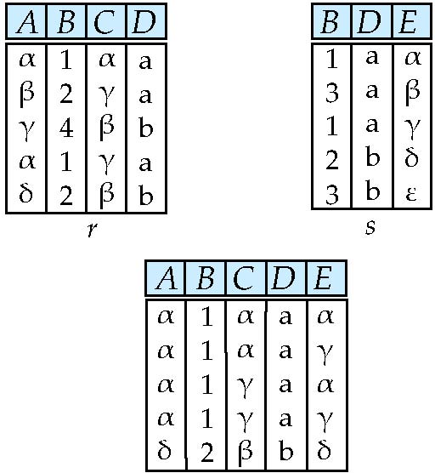
Natural Join Example
r s
∏ _{A, r.B, C, r.D, E} (σ _{r.B = s.B ˄ r.D = s.D} (r x s)))

Slide 31
Q: Find the names of all customers who have a loan at the “Perryridge” branch but do not have an account at any branch of the bank
A: ∏_{customer_name} (σ_{branch_name = “Perryridge”} (σborrower.loan_number = loan.loan_number(borrower x loan))) – ∏_{customer_name}(depositor)

Slide 32
Division
Notation: r ÷ s
Suited to queries that include the phrase “for all”
Let r and s be relations on schemas R and S respectively where R ⊆ S and
R = (A1, …, Am , B1, …, Bn )
S = (B1, …, Bn)
The result of r ÷ s is a relation on schema R – S = (A₁, …, A_{m})
r ÷ s = { t | t ∈ ∏ _{R-S} (r) ∧ ∀ u ∈ s ( tu ∈ r ) }
Where tu means the concatenation of tuples t and u to produce a single tuple

Slide 33
Division Example
A | B | C
α | 1 | X
β | 2 | Y
π | 3 | Z
β | 1 | W
α | 2 | Y
β | 2 | Y
π | 1 | X
B | C
1 | X
2 | Y
÷
s
A
α
r

Slide 34
Assignment Operator
Notation: ←
Provides a convenient way to express complex queries:
Write query as a sequential program consisting of
a series of assignments
followed by an expression whose value is displayed as a result of the query.
Assignment must always be made to a temporary relation variable

Slide 35
Assignment Operator
Find the names of all customers who have a loan at the “Perryridge” branch but do not have an account at any branch of the bank
A.∏_{customer_name} (σ_{branch_name = “Perryridge”} (σ_{borrower.loan_number =} _{loan.loan_number}(borrower x loan))) – ∏_{customer_name}(depositor)

Slide 36
Assignment Operator
temp1 ←σ_{borrower.loan_number =} _{loan.loan_number}(borrower x loan)
temp2 ← σ_{branch_name = “Perryridge”} (temp1)
temp3 ← ∏_{customer_name} (temp2)
temp4 ← ∏_{customer_name}(depositor)
result ← temp3 – temp4
The result to the right of the ← is assigned to the relation variable on the left of the ←
May use variable in subsequent expressions

Slide 37
Example Queries

Slide 38
Q1: Find the names of the customers who have a loan at the “Perryridge” branch
A: ∏_{customer_name} (σ_{branch_name=“Perryridge”}
(σborrower.loan_number = loan.loan_number(borrower x loan)))

Slide 39
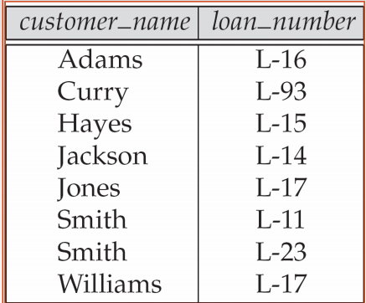
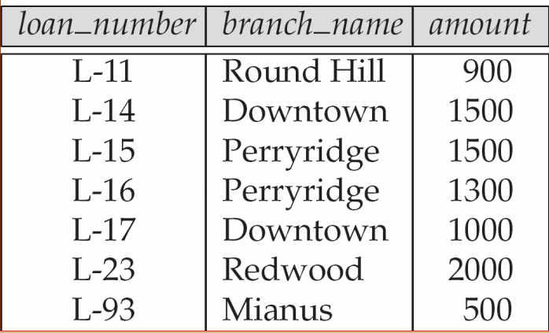
CN | B.LN | L.LN | BN | Am
Adams Adams Adams. .. .. Adams Curry Curry Curry .. .. Curry .. .. .. .. Williams Williams .. . Williams | L-16 L-16 L-16 .. . L-16 L-93 L-93 L-93 .. . L-93 L-16 L-16 .. . L-17 L-17 .. .. L-17 | L-11 L-14 L-15 .. . L-93 L-11 L-14 L-15 .. . L-93 L-14 L-15 .. . L-11 L-14 .. .. L-93 | RoundHill Downtown Perryridge . . Mianus RoundHill Downtown Perryridge . . Mianus Downtown Perryridge . . RoundHill Downtown .. .. Mianus | 900 1500 1500 . . 500 900 1500 1500 . . 500 1500 1500 . . 900 1500 500
Borrower
Borrower X loan
(56 records)
loan

Slide 40
Example Query-1
σborrower.loan_number = loan.loan_number (borrower x loan)))
CN | B.LN | L.LN | BN | Am
Adams | L-16 | L-16 | Perryridge | 1300
Curry | L-93 | L-93 | Mianus | 500
Hayes | L-15 | L-15 | Perryridge | 1500
Jackson | L-14 | L-14 | Downtown | 1500
Jones | L-17 | L-17 | Downtown | 1000
Smith | L-11 | L-11 | Roundhill | 900
Smith | L-23 | L-23 | Redwood | 2000
Williams | L-17 | L-17 | Downtown | 1000
∏_{customer_name} (σ_{branch_name=“Perryridge”})
Customer Name
Adams
Hayes

Slide 41
Example Query-1
The other possible relational algebra query to Find the names of the customers who have a loan at the “Perryridge” branch can be:
∏_{customer_name}(σborrower.loan_number = loan.loan_number (borrower x σ_{branch_name=“Perryridge”}loan))

Slide 42
CN | B.LN | L.LN | BN | Am
Adams Adams Curry Curry Hayes Hayes Jackson Jackson Jones Jones Smith Smith Smith Smith Williams Williams | L-16 L-16 L-93 L-93 L-15 L-15 L-14 L-14 L-17 L-17 L-11 L-11 L-23 L-23 L-17 L-17 | L-15 L-16 L-15 L-16 L-15 L-16 L-15 L-16 L-15 L-16 L-15 L-16 L-15 L-16 L-15 L-16 | Perryridge Perryridge Perryridge Perryridge Perryridge Perryridge Perryridge Perryridge Perryridge Perryridge Perryridge Perryridge Perryridge Perryridge Perryridge Perryridge | 1500 1300 1500 1300 1500 1300 1500 1300 1500 1300 1500 1300 1500 1300 1500 1300
Borrower
loan
(borrower x σ_{branch_name=“Perryridge”}loan)
(16 records)

Slide 43
Example Query-1
σborrower.loan_number = loan.loan_number (borrower x σ_{branch_name=“Perryridge”}loan)
CN | B.LN | L.LN | BN | Am
Adams | L-16 | L-16 | Perryridge | 1300
Hayes | L-15 | L-15 | Perryridge | 1500
∏_{customer_name}(σborrower.loan_number = loan.loan_number (borrower x σ_{branch_name=“Perryridge”}loan))
Customer Name
Adams
Hayes

Slide 44
Example Query-2
Q: Find the names of all customers who have a loan but do not have an account at any branch of the bank

Slide 45
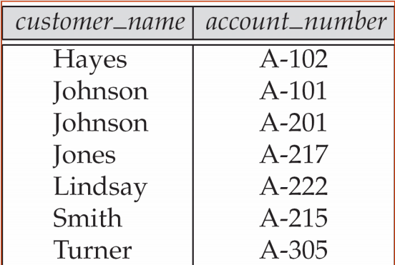
Example Query2
Borrower
Depositor
Loan

Slide 46
Example Query-2
Customer Name
Adams
Curry
Hayes
Jackson
Jones
Smith
Williams
Customer Name
Hayes
Johnson
Jones
Lindsay
Smith
Turner
Customer Name
Adams
Curry
Jackson
=
result
temp1
temp2
temp1 ← ∏_{customer_name} ( borrower loan)
temp2 ← ∏_{customer_name}(depositor)
result ← temp1 – temp2

Slide 47
Example Query-3
Q: Find the largest account balance
Strategy:
Find those balances that are not the largest
Rename account relation as d so that we can compare each account balance with all others
Find account balances that were not found in the earlier step by set difference operation
A: ∏_{balance}(account) - ∏_{account.balance}(σ_{account.balance} _{< d.balance} (account x ρ_{d} (account)))

Slide 48
Example Query-4
Q: Find the names of the customers who have account at all branches located in Brooklyn city.
Strategy:
Find all the branches of the bank located in the Brooklyn city
Find customer name along with all the branches in which they have account
Perform the division operation

Slide 49
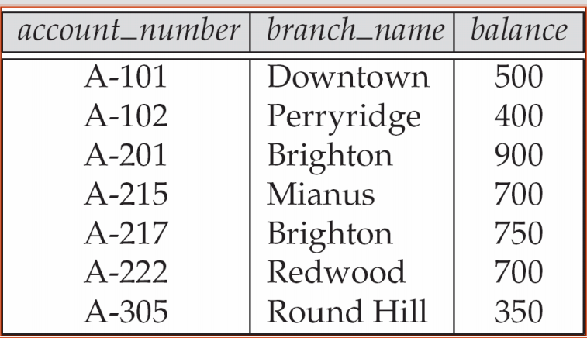
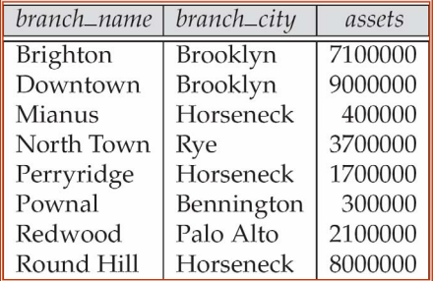
depositor
account
branch

Slide 50
Example Query - 4
A: ∏_{customer_name, branch_name} (depositor account) ÷
_{branch_name} (σ_{branch_city = “Brooklyn”} (branch))
Customer_name | branch_name
Hayes | Perry Ridge
Johnson | Downtown
Johnson | Brighton
Jones | Brighton
Lindsay | Redwood
Smith | Mianus
Turner | Round Hill
branch_name
Brighton
Downtown
÷
∏_{branch_name} (σ_{branch_city = “Brooklyn”} (branch))
∏_{customer_name, branch_name} (depositor account)

Slide 51
Practice Problems
customer (cid, name)
transaction (tid, cid, pid)
product (pid, pname)
Q: Write an RA query to find the name of all customers who have bought both bread and butter in the same transaction

Slide 52
Practice problems
Which information does the following RA expression extract from the following database schema:
loan(loan_number, branch_name, amount)
deposit(customer_name, account_number)
account(account_number, branch_name, balance)
Q: ∏_{deposit.balance}(σ_{deposit.balance< d.balance} (deposit X ρ_{d} (account)))

Slide 53
Extended Relational Algebra Operator
Generalized projection
Aggregate functions
Outer Join

Slide 54
Generalized projection
Extends the projection operation by allowing arithmetic functions to be used in the projection list
Example:
credit_info(customer_name, limit, credit_balance)
Q: Find how much more each person can spend:
∏customer_name, limit – credit_balance (credit_info)

Slide 55
Aggregate Functions
Aggregation function: Takes a collection of values and returns a single value as a result.
avg: average value
min: minimum value
max: maximum value
sum: sum of values
count: number of values

Slide 56
Aggregate Functions
Aggregate operation: In relational algebra E
_{G1, G2 …, G}ɡ_{F1(A1),F2(A2),….Fn(An)}(E)
E is any relational-algebra expression
G1, G2 …, Gn is a list of attributes on which to group (can be empty)
Each Fi is an aggregate function
Each Ai is an attribute name

Slide 57
Aggregate Functions
Sum(balance)
4300
g_{sum(balance)}(account)
account

Slide 58
Aggregate Functions
branch_name | Sum(balance)
Downtown | 500
Perryridge | 400
Brighton | 1650
Mianus | 700
Redwood | 700
Round Hill | 350
account
_{branch_name}g_{sum(balance)}(account)

Slide 59
Aggregate Functions
 Result of aggregation does not have a name
Can use rename operation to give it a name
_{branch_name}g_{sum(balance)} _{as sum_balance} (account)
Sum(balance)
4300
sum_balance
account

Slide 60
Outer Join
An extension of the join operation that avoids loss of information
Computes the join and then adds tuples form one relation that does not match tuples in the other relation to the result of the join
Uses null values:
null signifies that the value is unknown or does not exist
All comparisons involving null are false by definition
We shall study precise meaning of comparisons with nulls later

Slide 61
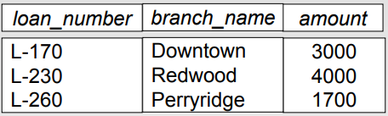
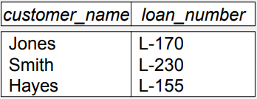
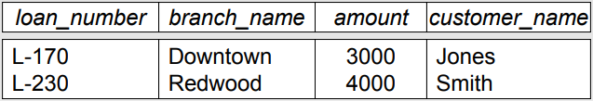
Outer Join
loan
borrower
loan borrower

Slide 62
